Slide 1
US Decision Science
NS Retiering Exercise
National Level Analysis
April 06, 2007

Slide 2
Objective
Review national level results of NS retiering exercise for NS Office based sales forces
Number of recommended tiers and call goal by tier
  Comparison of call goal with historical call activity by tier
  Breakout of brand segments by tier
  Comparison of recommended tier with current tier
Implication of tiering and call goals on brand level details
  Compare with call plan details
  Review segment level detail frequency
Review distribution of call capacity at territory level

Slide 3
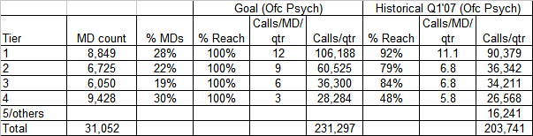
Recommended tiers and call goal by tier (Psych Ofc)
Target universe
MDs in CDM (as of April 1, 07) and
Tier 1-4 in Psych laptop (as of April 1, 07) OR APS 1-2, Zypx 1-10 and
Meeting FQ3’07 TTP rules
DPNP only targets in DPNP focus territories are excluded
Tiering method
Tier 1 – ADP 7-10 OR (APS 7-10, Zypx 1-10)
Tier 2 – ADP 3-6 OR (APS 3-6, Zypx 1-10) and not in Tier 1
Tier 3 – DPNP targets
Tier 4 – Rest of MDs in target universe
84% of Strattera targets are in Tier 1-2
Adjusting for 7.6% float in Mar’07
Goal is 5% more than historical capacity
220,466
Total call goal for the sleeve is 5% more than what was delivered in Q1’07
  Historical average calls/day is about 7.5 calls/day but the goal is 8 calls/day

Slide 4








Brand segments vs tier (Psych Ofc)
MD Count
% Mkt TRx
Recommended tier
Recommended tier
Cymbalta-MDD
Cymbalta-DPNP
Zyprexa
Strattera

Slide 5
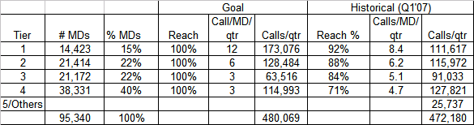
Recommended tiers and call goal by tier (NSPC)
Target universe
MDs in CDM (as of April 1, 2007) and
Tier 1-4 in NSPC laptop (as of April 1, 2007) and
Meeting FQ3’07 TTP rules
Tiering method
Tier 1 – ADP 7-10 OR APS 3-10, Zypx 6-10
Tier 2 – ADP 5-6 OR ADD 7-10 PCP
Tier 3 – Strattera targets not in Tier 1,2
Tier 4 – Rest of MDs in the target universe
85% of Zyprexa targets are in Tier 1-3
48% of Tier 3 MDs are ped tgts for Strattera
DPNP targets are in Tier 4
Adjusting for 5.4% float in Mar’07
Goal is 4% less than historical capacity
499,395
Total call goal for the sleeve is 4% less than what was delivered in Q1’07

Slide 6




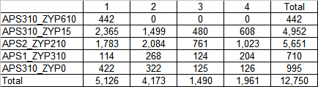
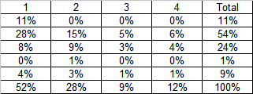
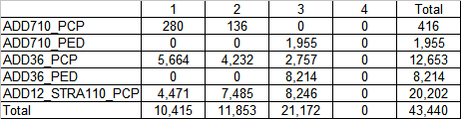
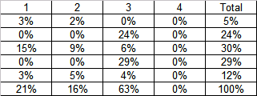
Brand segments vs tier (NSPC)
MD Count
% Mkt TRx
Recommended tier
Recommended tier
Cymbalta-MDD
Cymbalta-DPNP
Zyprexa
Strattera

Slide 7
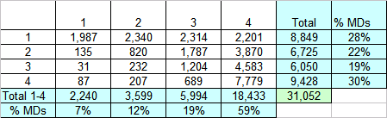
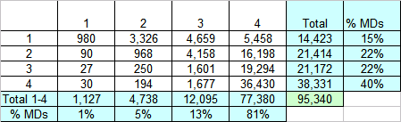
Recommended tier vs current tier
Psych Ofc
Laptop tier (Mar’06)
Compared to current tiering, the recommended tiering has
  38% of MDs in the same tier
  69% of MDs that differ by less than 2 tiers
Recommended tier
NSPC
Laptop tier (Mar’06)
Compared to current tiering, the recommended tiering has
  42% of MDs in the same tier
  72% of MDs that differ by less than 2 tiers
Recommended tier

Slide 8
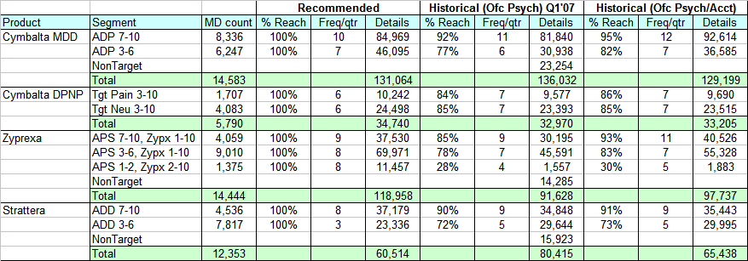
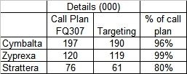
Frequency by brand (Psych Ofc)
Based on targets for Psych, Psych-D terrs
Comparison to call plan details

Slide 9
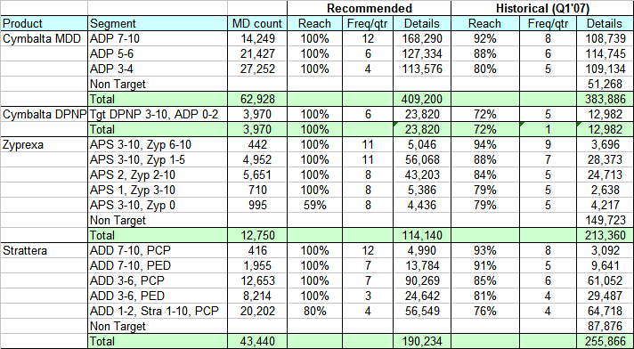
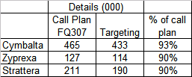
Frequency by brand (NSPC)
Comparison to call plan details

Slide 10
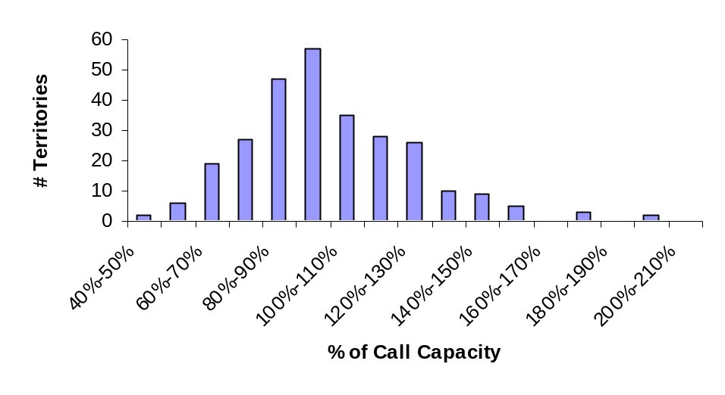
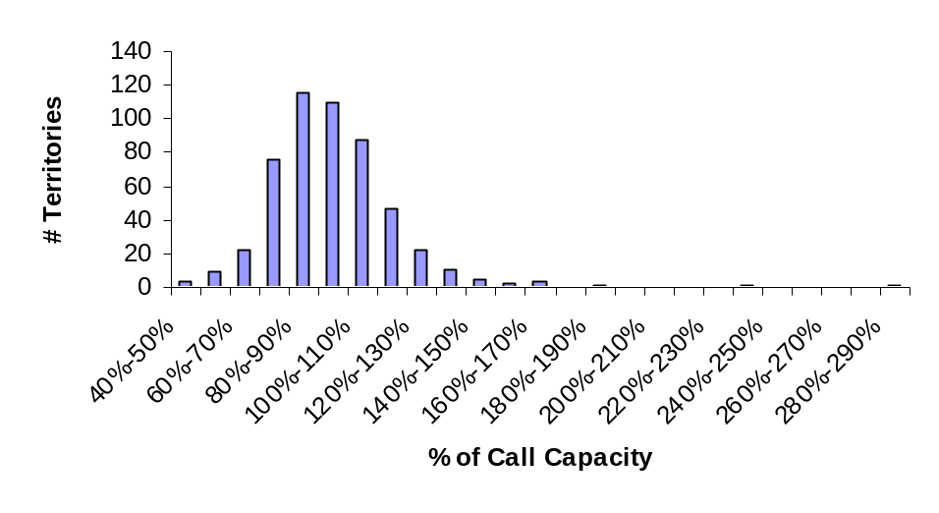
Distribution of territory level capacity
92 terrs are in 90%-110% capacity range
Psych
83 terrs have workload greater than 110% of capacity
198 terrs are in 90%-110% capacity range
NSPC
93 terrs have workload greater than 110% of capacity

Slide 11
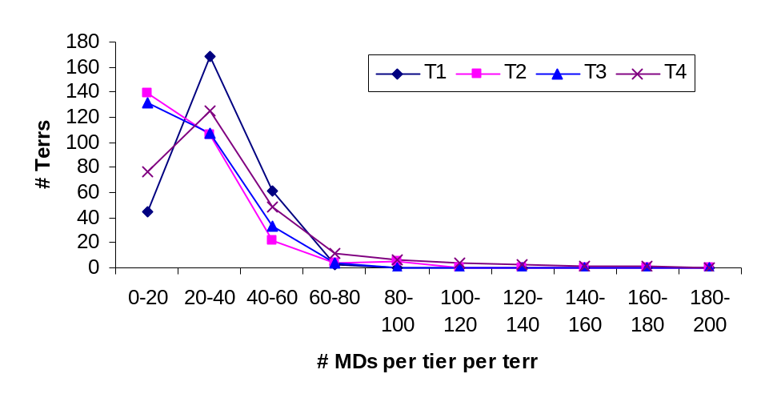
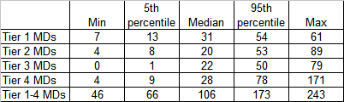
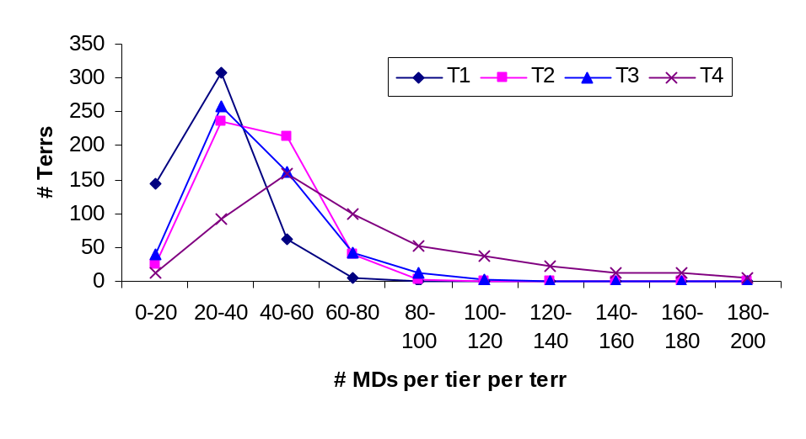
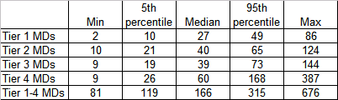
Distribution of MDs by territory
Psych
NSPC

Slide 12
Appendix

Slide 13
Data sources
MD universe used for the retiering exercise is CDM data as of April 1, 2007
Deciles are 3 month deciles ending Feb’07 for all MDs except those in VT, NH
For VT, NH MDs, 3 month decile ending Jun’06 are used
Business rules on brand segment, tiering is based on the targeting business rules document
Laptop tiers are based on laptop as of April 1, 2007

